Slide 1
Analysis of Stroke Cases among Patients

Slide 2

STROKE:THE SILENT KILLER
LEADING CAUSE OF LONG-TERM DISABILITY IN THE US
ABOUT 700 000 PEOPLE SUFFER FROM STROKE EACH YEAR
THE 3RD LARGEST CAUSE OF DEATH
OF THE 700 000 STROKES: 500 000 ARE FIRST ATTACKS, 200 000 ARE RECURRENT

Slide 3
PROBLEM STATEMENT
DO PATIENTS WITH HIGH LEVEL OF GLUCOSE WHO HAD STROKES TEND TO HAVE HIGHER LEVELS OF GLUCOSE COMPARED TO PATIENTS WHO DIDN'T HAVE STROKE?
IS AGE A CONTRIBUTING FACTOR IN STROKES?
IS BODY MASS INDEX A CONTRIBUTING FACTOR IN STROKES?
DO PATIENTS WITH STROKES HAVE OTHER LIFE THREATENING CONDITIONS?

Slide 4
DATA ANALYZED
Dataset of 5110 patients
Variables include: age, glucose level, body mass index
Raw Data Available Here

Slide 5
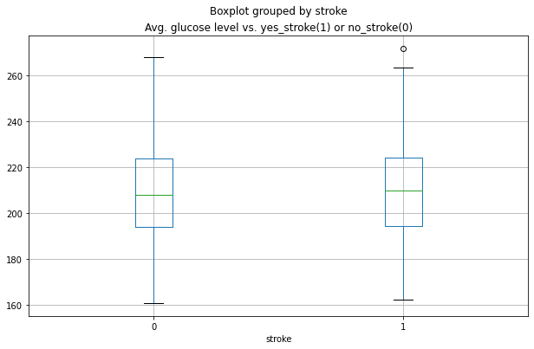
There’s no statistically significant difference between glucose level of people with and without stroke.
The glucose level is not a direct contributing factor in strokes
The difference of 1.66 is not statistically significant

Slide 6
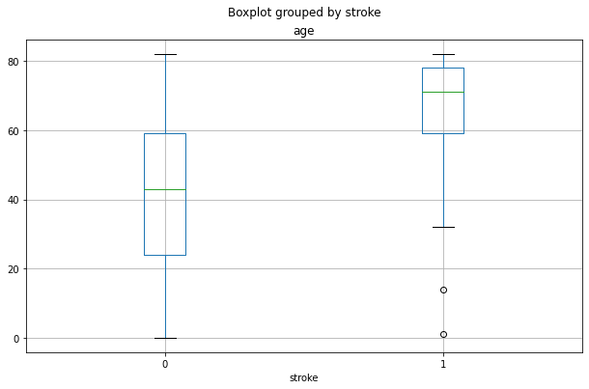
There is statistically significant difference between age of people who had stroke and who didn’t.
The average age difference between patients with and without stroke is 26 years
Age is a factor in stroke cases

Slide 7
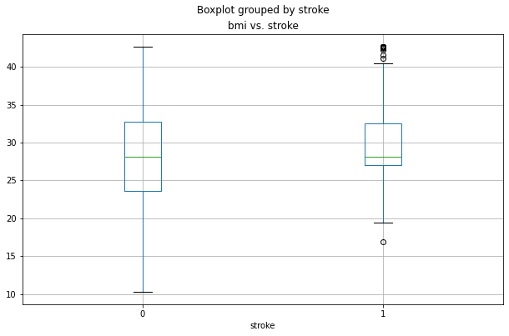
There is statistically significant difference between body mass index of people who had stroke and who didn’t.
With 95% confidence the average bmi of people with stroke is 0.73 to 2.12 higher compared to people without stroke
Bmi is a factor in stroke cases
Bmi should be considered with other factors, like age. because average difference is small

Slide 8
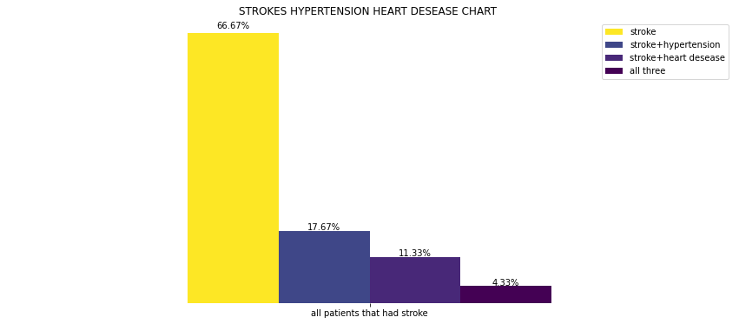
What other conditions patients have?
66% had stroke alone
18% had stroke and hypertension
11.3%had stroke and heart disease
4.3% had both hypertension and heart condition.

Slide 9
Summary
Age is a significant factor in strokes with average difference of 26 years between stroke/no stroke groups
Body mass index is a significant factor
Glucose Level is not a significant factor in stroke cases
Recommendations
While body mass index is a significant factor it should be considered in combination with other factors in evaluation of stroke risks
Further studies are needed to evaluate risk scores by other contributing factors. The data has shown hypertension and heart disease were present in one third of cases.

Slide 10
QUESTIONS?

Slide 11
THANK YOU

